Slide 1
Introduction to Python
Prof. Asim Tewari IIT Bombay

Slide 2
Agenda
What is Python?
Why Python?
Python's Syntax
Data Types in Python
Control Flow (Conditional Statements and Loops)
Introduction to Object-Oriented Programming (OOP)
Data Handling Tools: Pandas and NumPy
Conclusion

Slide 3
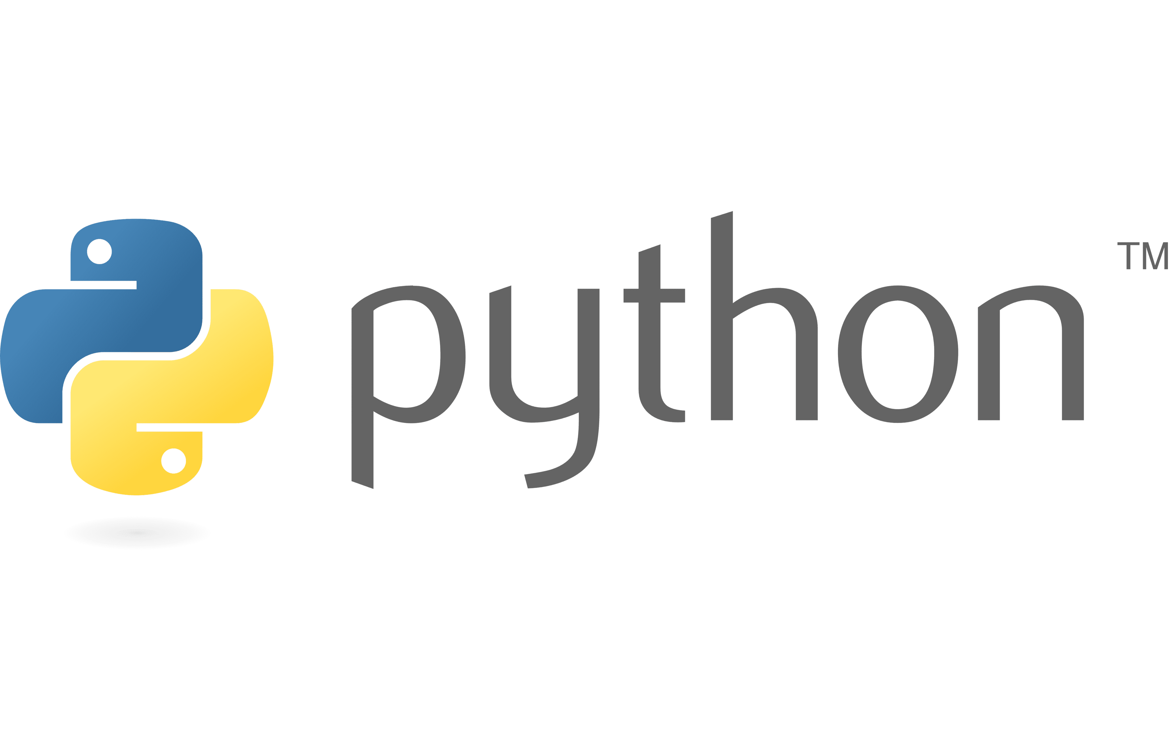
What is Python?
Python is a high-level, interpreted, and general-purpose programming language.
Created by Guido van Rossum and first released in 1999

Slide 4
Why Python?
Readable and expressive syntax.
Extensive standard libraries.
Versatile applications: web development, data science, artificial intelligence, etc.
Large, supportive community.

Slide 5
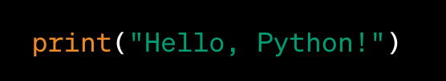
Python's Syntax

Slide 6
What are Data Types?
Data types classify & define the nature of the data.
Example:
Numeric types – (eg. 10, -20)
Text Types – (eg. ‘h’, ‘H’, ‘Hello’)
Boolean types – (eg. True, False)
Importance:
Proper storage & interpretation of data.
Optimize memory usage.
Compatibility with libraries and frameworks

Slide 7
Understanding Data Types in Python, NumPy, and Pandas
Python – Vanilla Python
NumPy, Pandas - Libraries

Slide 8
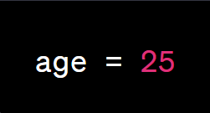
What are Variables
Variables in Python are used to store and manipulate data.
A variable is a named location in memory that holds a value.
Variables are created by assigning a value to a name using the assignment operator (=).
They can store different data types such as numbers, strings, lists, etc.

Slide 9
Print statements in python
Print helps display output on the console screen.
Types of print method:
Concatenation
Formatting with % Operator
Formatting with Comma
f-String Method

Slide 10
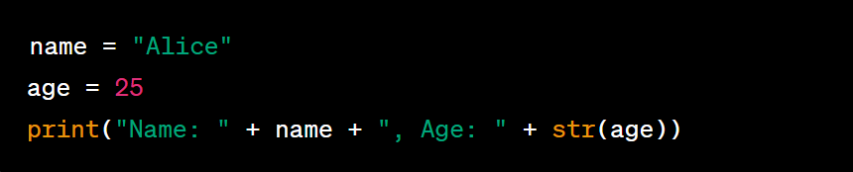
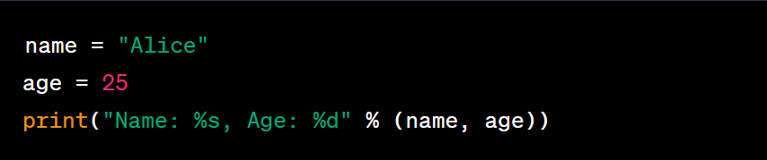
Print Statement Types
Concatenation
Formatting with % operator

Slide 11
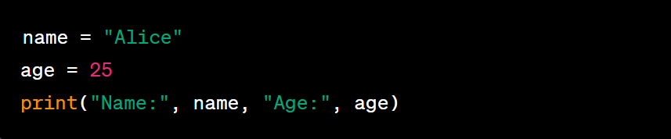
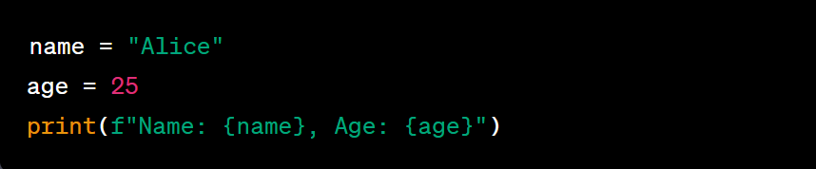
Print Statement Types
Formatting with comma
f-String Method

Slide 12
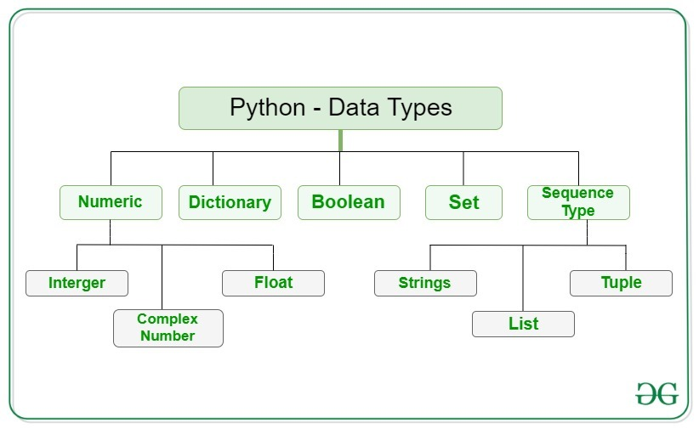
Python Data Types
Vanilla Python Data Types:

Slide 13
Understanding Numeric Data Types
Numeric data types represent numerical values in programming.
Common numeric data types:
Integer: Whole numbers without decimal points (e.g., 10, -5).
Float: Floating-point numbers with decimal points (e.g., 3.14, -0.5).
Complex: Numbers with a real and imaginary part (e.g., 2 + 3j).
Use cases:
Integer: Counting, indexing, and discrete quantities.
Float: Calculations involving decimal precision, measurements.
Complex: Mathematical calculations involving complex numbers.
Advantages:
Precise representation of numerical values.
Support for arithmetic and mathematical operations.

Slide 14
Numeric Data Types in Python
1. Integers (int)
Contains both +ve and –ve Whole Numbers (w/o fractions or decimals)
In Python there is no limit to how long an integer can be
Example 120, -89, 56

Slide 15
Numeric Data Types in Python
2. Float (float)
Contains both +ve and –ve whole number and the fractional part separated by a decimal point. (w/o fractions or decimals)
No limit restriction
Optionally, the character e or E followed by an integer may be appended to specify scientific notation.
Example 120.58, -89.04, 56.147

Slide 16
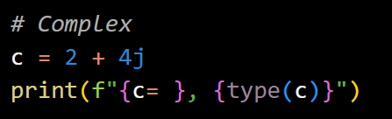
Numeric Data Types in Python
3. Complex (complex)
Complex number is represented by a complex class. It is specified as (real part) + (imaginary part)j.
No limit restriction

Slide 17
Numeric Data Type Operators
Numeric data types in Python support various operators for performing operations.
These operators allow you to manipulate and perform calculations with numeric values.
Common operators include:
Arithmetic Operators
Assignment Operators
Comparison Operators

Slide 18






Arithmetic Operators
Addition (+): Combines two numbers, resulting in their sum.
Subtraction (-): Subtracts one number from another.
Multiplication (*): Multiplies two numbers, producing their product.
Division (/): Divides one number by another, yielding the quotient.
Modulo (%): Computes the remainder of division.
Exponentiation (**): Raises a number to a power
Addition
Multiplication
Modulo
Subtraction
Division
Exponentiation

Slide 19




Comparison Operators
Equal to (==): Checks if two numbers are equal.
Not equal to (!=): Checks if two numbers are not equal.
Greater than (>), Greater than or equal to (>=): Compares if one number is greater than or equal to another.
Less than (<), Less than or equal to (<=): Compares if one number is less than or equal to another.
Equal to
Greater than
Not equal to
Less than

Slide 20


Assignment Operators
Assign (=): Assigns a value to a variable.
Compound assignment operators (+=, -=, *=, /=): Perform an operation and assign the result to a variable in one step.
Assign
Compound Assignment Operators

Slide 21
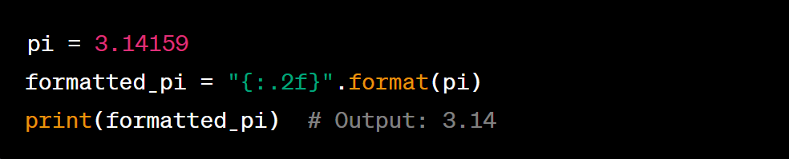
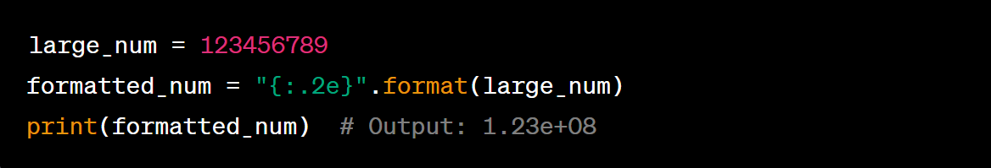
Float Display Formats
Fixed-Point Notation
Scientific Notaion

Slide 22
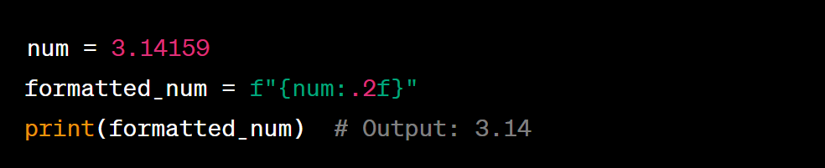
Float Display Formats
Fixed-Point Notation

Slide 23
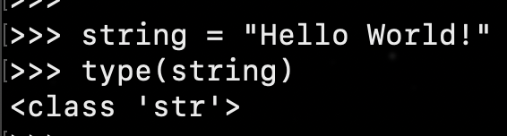
Sequence Data Types in Python
1. Strings (str)
Arrays of bytes representing Unicode characters.
Collection of one or more characters put in a ‘single quote’, “double quote”, or ‘‘‘triple quote’’’.
In python there is no character data type, a character is a string of length one. It is represented by str class.

Slide 24
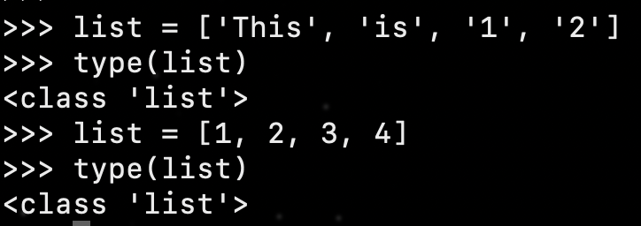
Sequence Data Types in Python
2. List(list)
Lists are ordered collection of data.
They are like arrays of C/C++.
It is very flexible as the items in a list do not need to be of the same type.
Lists in Python can be created by just placing the sequence inside the square brackets[].

Slide 25
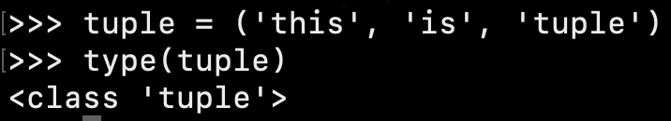
Sequence Data Types in Python
3. Tuple (tuple)
Just like a list, a tuple is also an ordered collection of Python objects.
Tuples cannot be modified after it is created.
Tuples are created by encompassing comma separated values in parenthesis.

Slide 26
String Encoding in Python
Python provides several string encoding schemes to represent and handle text data.
These encoding schemes define how characters are mapped to binary representations.
Types:
ASCII Encoding
UTF-8 Encoding
UTF-16 Encoding
Latin-1 Encoding
Unicode Encoding

Slide 27
ASCII Encoding - (American Standard Code for Information Interchange)
Represents English characters and basic symbols.
Uses 7 bits to represent 128 characters.
Range: 0 to 127.
Examples:
'A' is represented as 65.
'a' is represented as 97.
Limitation: Limited support for non-English characters and symbols.
Note: The slide can include visual representations of ASCII characters (e.g., 'A', 'a') to enhance visual appeal.

Slide 28
UTF-8 Encoding – (Universal Character Set Transformation Format-8-bit)
Widely used encoding for international text.
Variable-length encoding, uses 1 to 4 bytes.
Supports characters from different languages and scripts.
Efficient representation for ASCII characters (1 byte).
Examples:
Latin characters represented in 1 byte.
Non-Latin characters represented in 2 to 4 bytes.
Advantage: Compatible with ASCII.
Note: The slide can include a visual representation of UTF-8 logo or icon associated with international text.

Slide 29
UTF-16 Encoding – (Universal Character Set Transformation Format-16-bit)
Variable-length encoding, uses 2 or 4 bytes.
Supports characters from different languages and scripts.
Commonly used for storing Unicode text.
Examples:
Latin characters represented in 2 bytes.
Supplementary characters represented in 4 bytes.
Advantage: Better support for characters beyond Basic Multilingual Plane.
Note: The slide can include a visual representation of UTF-16 logo or icon associated with Unicode text.

Slide 30
Latin-1 Encoding – (ISO 8859-1)
Represents characters in Western European languages.
Uses a single byte for each character.
Range: 0 to 255.
Examples:
'A' is represented as 65.
'Å' is represented as 197.
Limitation: Limited support for non-Western European characters.
Note: The slide can include visual representations of Latin-1 characters (e.g., 'A', 'Å') to enhance visual appeal.

Slide 31
Unicode Encoding– (ISO 8859-1)
Unicode encoding represents characters from all languages and scripts.
Uses a fixed 2-byte representation (UTF-16) or variable-length encoding (UTF-8).
Provides a unique code point for each character.
Examples:
'A' is represented as U+0041.
'漢' is represented as U+6F22.
Advantage: Universal support for diverse languages and scripts.
Note: The slide can include visual representations of Unicode logo or icon associated with diverse languages and scripts.

Slide 32
String Manipulation
String manipulation refers to operations performed on strings to modify, extract, or combine their contents.
Python provides several built-in methods and operators for string manipulation.

Slide 33
String Manipulation Concepts
Concatenation: Combining two or more strings together using the + operator.
Length: Determining the length of a string using the len() function.
Indexing: Accessing individual characters of a string using indexing notation (e.g., string[0]).
Slicing: Extracting a portion of a string using a range of indices (e.g., string[1:5]).
Upper/Lowercase Conversion: Changing the case of the letters using the upper() and lower() methods.
Replace: Replacing specific substrings within a string using the replace() method.
Split: Splitting a string into a list of substrings based on a delimiter using the split() method.
Join: Joining a list of strings into a single string using the join() method.

Slide 34
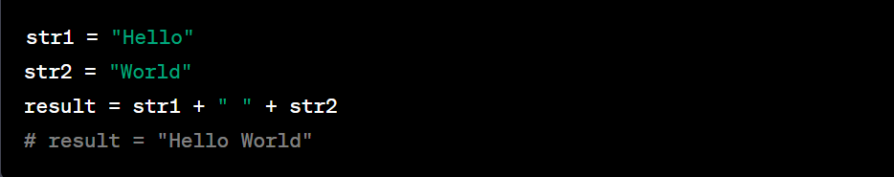
String Manipulation Types
Concatenation
Combine strings using the + operator.
Create a new string by joining the contents of the individual strings together.

Slide 35
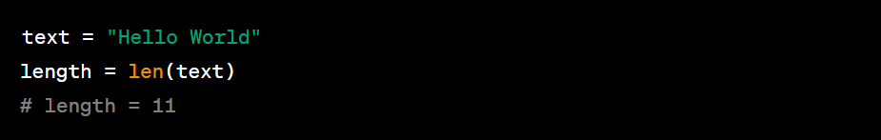
String Manipulation Types
Length
Determine the length of a string using the len() function.
The length of a string refers to the number of characters it contains.
The len() function returns an integer value representing the length.

Slide 36
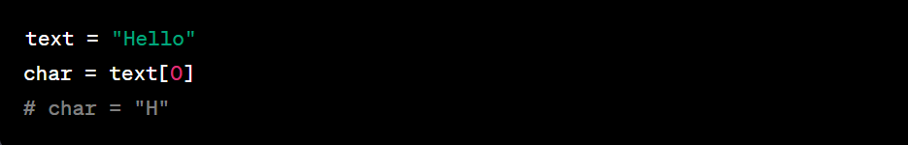
String Manipulation Types
Indexing
Indexing allows accessing individual characters of a string using indices.
In Python, indices start from 0 for the first character and increment by 1 for subsequent characters.
Use square brackets [] notation with the index inside to access specific characters.

Slide 37
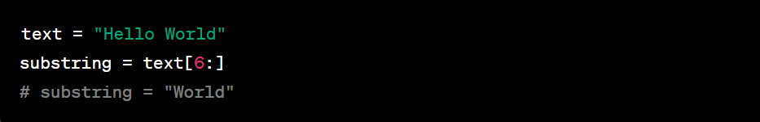
String Manipulation Types
Slicing
Slicing extracts a portion of a string using a range of indices.
Specify the start and end indices separated by a colon within square brackets [].
The end index is exclusive (not included in the slice).

Slide 38
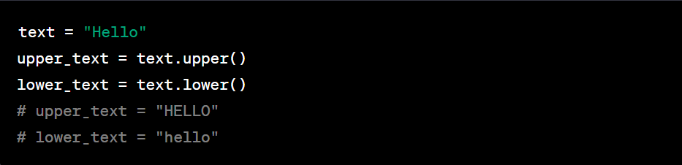
String Manipulation Types
Upper/Lower Case Conversion
Upper() and lower() methods change the case of letters in a string.
upper() converts all characters to uppercase.
lower() converts all characters to lowercase.

Slide 39
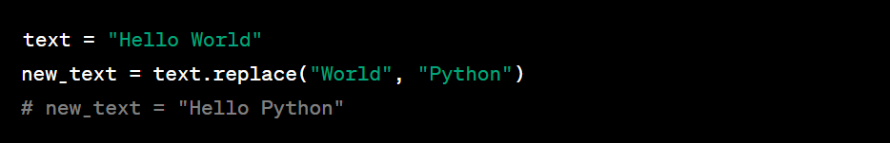
String Manipulation Types
Replace
The replace() method substitutes specific substrings within a string with a new value.
Provide the substring to be replaced and the replacement value as arguments to the method.

Slide 40
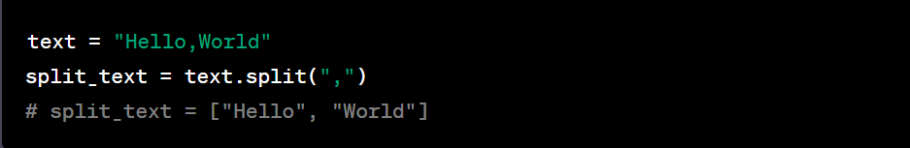
String Manipulation Types
Split
The split() method divides a string into a list of substrings based on a delimiter.
Specify the delimiter as an argument to the method.
Returns a list of substrings.

Slide 41
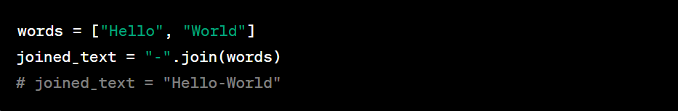
String Manipulation Types
Join
The join() method merges a list of strings into a single string.
Provide the list as an argument to the method.
Returns a string with the list elements joined by the specified separator.

Slide 42
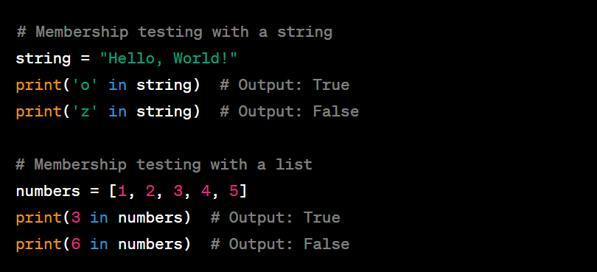
String Manipulation Types
In
Membership testing allows checking if an element is present in a sequence.
The in operator is used for membership testing in Python.
The function returns boolean values (True, False)

Slide 43

Boolean Data Types in Python
Data type with one of the two built-in values, True or False.
Note – True and False with capital ‘T’ and ‘F’ are valid booleans otherwise python will throw an error.

Slide 44
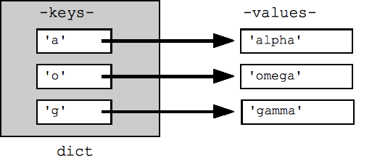
Dictionary in Python
A dictionary in Python is an unordered collection of key-value pairs.
Each key is unique and associated with a value.
Dictionaries are defined using curly braces {} and can be modified.

Slide 45
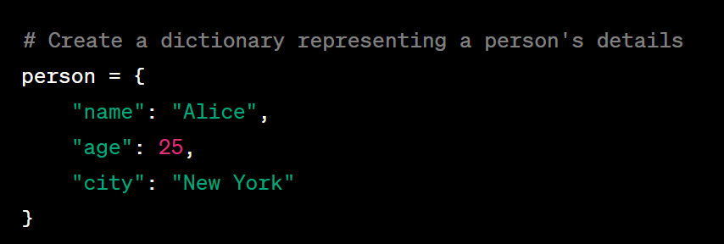
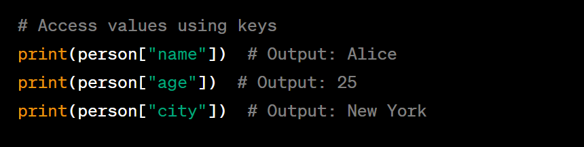
Dictionary Example

Slide 46
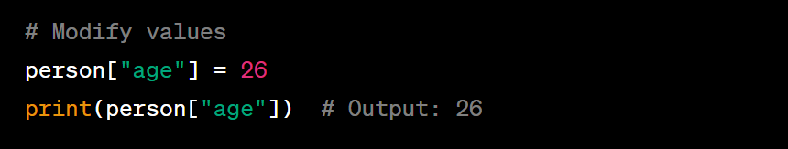
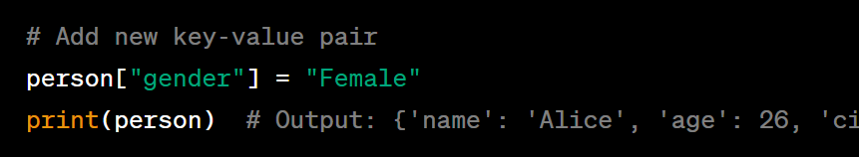
Dictionary Example

Slide 47
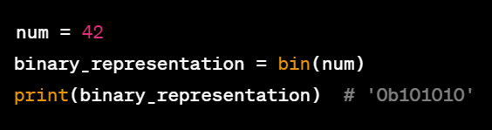
Binary Representation of Data
In Python, you can use the built-in bin() function to represent various data types, such as strings, integers, or any other data type, in binary format.
Representing an Integer in Binary:

Slide 48
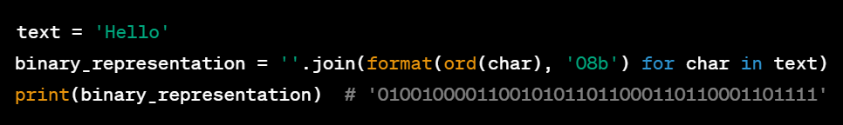
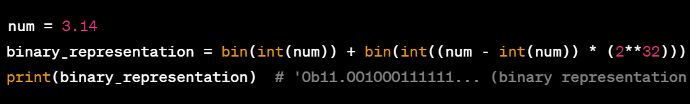
Binary Representation of Data
Representing a String in Binary (using ASCII encoding):
Representing a Float in Binary:

Slide 49
Binary Representation of Data
Representing a Float in Binary:

Slide 50
Hexadecimal Representation of Data
The hex() function is used to convert an integer to its hexadecimal representation, prefixed with '0x'.
For representing strings or other data types as hexadecimal, each character is converted to its ASCII value using the ord() function.
The format() function is then used with a width of 2 and 'x' format specifier to represent each ASCII value in hexadecimal.
To represent a float in hexadecimal, the struct module is used. The float value is packed into a byte string using the pack() function, and then the resulting byte string is unpacked as a 64-bit unsigned integer ('>Q') using unpack(). Finally, the hex() function is used to obtain the hexadecimal representation.
Note that the hex() function adds the '0x' prefix to indicate that the output is in hexadecimal format.

Slide 51
Hexadecimal Representation of Data
Representing an Integer in Hexadecimal:
Representing a String in Binary (using ASCII encoding):

Slide 52
Data Type Conversion Example
Common data type conversion functions include:
str(): Converts a variable to a string data type.
bin(): Converts a variable to a binary string representation.
hex(): Converts a variable to a hexadecimal string representation.
Data type conversion allows for flexibility in handling and manipulating data based on specific requirements.

Slide 53


Data Type Conversion Example
Integer to String
String to Binary

Slide 54
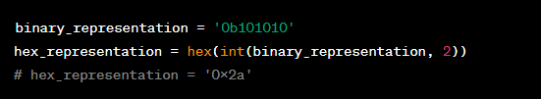
Data Type Conversion Example
Binary to Hexadecimal

Slide 55
NumPy Library Python

Slide 56
Introduction to NumPy
NumPy is a Python library.
NumPy is used for working with arrays.
NumPy is short for "Numerical Python".
Numpy Features:
Typed multidimensional arrays (matrices)
Fast numerical computations (matrix math)
High-level math functions

Slide 57
Features of NumPy
Multidimensional Arrays:
NumPy's main object is the ndarray (N-dimensional array), which allows efficient storage and manipulation of homogeneous data.
Data Types:
NumPy provides a range of data types, including integers, floating-point numbers, complex numbers, and more.
Data types in NumPy are more efficient in terms of memory and computational performance compared to standard Python data types.
Mathematical Operations:
NumPy enables performing mathematical operations on entire arrays efficiently.
It includes functions for basic mathematical operations, linear algebra, Fourier transforms, and more.

Slide 58
NumPy Data Types
NumPy offers a range of efficient data types for numerical computation.
Common NumPy data types include:
int: Integer data types (e.g., int8, int16, int32, int64).
float: Floating-point data types (e.g., float16, float32, float64).
complex: Complex number data types (e.g., complex64, complex128).
bool: Boolean data type (True or False).
object: Object data type (allows storing any Python object).
string: String data type.

Slide 59
Numeric Operations with NumPy
NumPy provides efficient numerical operations for arrays and matrices.
Common numeric operations include:
Mathematical functions: sin, cos, exp, log, etc.
Statistical functions: mean, median, std, var, etc.
Linear algebra operations: dot product, matrix multiplication, eigenvalues, etc.
Element-wise operations: addition, subtraction, multiplication, division, etc.
Broadcasting: Perform operations on arrays of different sizes.

Slide 60
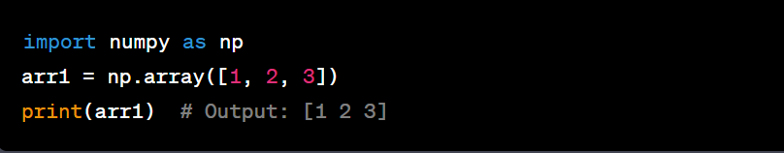
Array Creation in NumPy
NumPy provides various methods for creating arrays.
Common ways to create arrays include:
np.arr()
Convert Python lists or tuples to arrays.

Slide 61
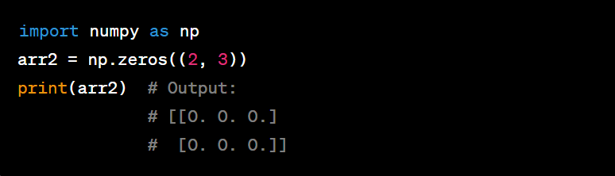
Array Creation in NumPy
np.zeros()
Create an array filled with zeros.

Slide 62
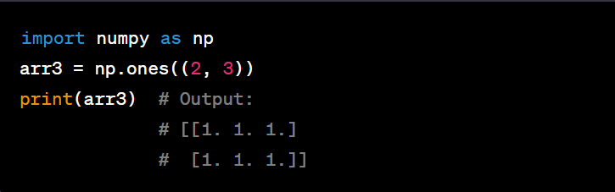
Array Creation in NumPy
np.ones()
Create an array filled with ones.

Slide 63
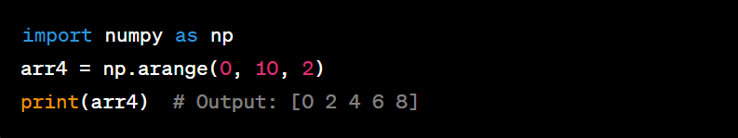
Array Creation in NumPy
np.arange()
Create an array with a range of values.

Slide 64
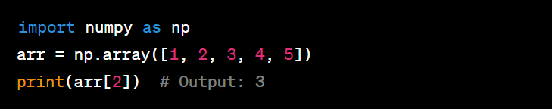
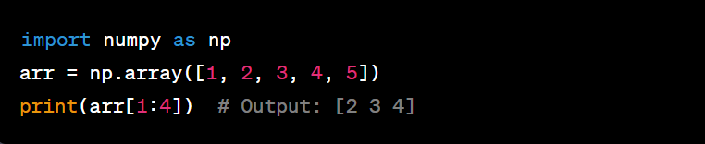
Array Indexing and Slicing in NumPy
NumPy allows indexing and slicing of arrays to access and manipulate specific elements or subarrays.
Array indexing and slicing operations include:
Indexing:
Slicing:

Slide 65
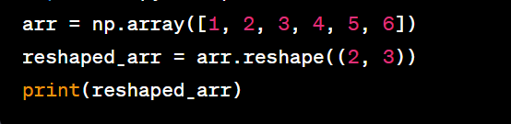
Array Manipulation in NumPy
NumPy provides functions for manipulating arrays to reshape, resize, and modify their structure.
Common array manipulation operations include:
Reshaping

Slide 66
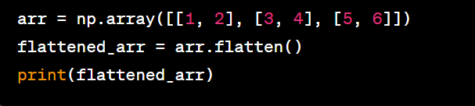
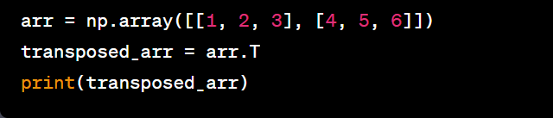
Array Manipulation in NumPy
Flatenning
Transposing

Slide 67
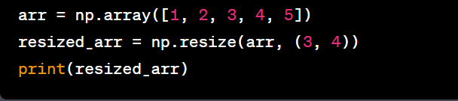
Array Manipulation in NumPy
Resizing

Slide 68
Broadcasting in NumPy
Broadcasting is a powerful feature in NumPy that allows performing operations on arrays with different shapes.
It eliminates the need for explicit loops and enables efficient element-wise operations.
Broadcasting rules:
If arrays have different ranks, the lower-rank array is broadcasted to match the shape of the higher-rank array.
If arrays have the same rank but different shapes, the arrays are broadcasted along the dimensions that are singleton (size 1).
Broadcasting enables efficient operations on arrays without the need for explicit size matching or copying.

Slide 69
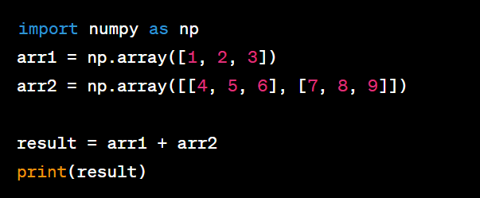
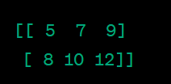

Broadcasting in NumPy

Slide 70
NumPy vs. Vanilla Python Data Types
NumPy data types offer several advantages over vanilla Python data types for numerical computing:
Memory Efficiency:
NumPy data types are more memory-efficient, allowing for the storage of large arrays and matrices.
This is crucial for handling large datasets and complex computations.
Computational Performance:
NumPy data types provide optimized mathematical operations, resulting in faster computations.
Vectorized operations on arrays eliminate the need for explicit loops, improving efficiency.
Specialized Functions:
NumPy provides a rich collection of specialized functions and operations tailored for numerical computing.
These functions make complex mathematical operations easier and more efficient to implement.
Interoperability:
NumPy data types have enhanced compatibility with other scientific computing libraries and tools.
This allows seamless integration with popular data analysis and visualization libraries.

Slide 71
Disadvantages of NumPy Data Types
While NumPy data types offer numerous advantages, they also have some limitations:
Complexity:
Working with NumPy requires understanding its syntax and functions, which may have a learning curve.
Complex operations or advanced features may require additional knowledge.
Limited Flexibility:
NumPy arrays have a fixed size, making it less flexible for dynamic data structures.
Modifying array size or shape requires creating a new array, which can be memory-intensive for large arrays.
Overhead:
NumPy arrays have additional memory overhead compared to native Python lists.
This overhead can be noticeable when working with small datasets or when memory optimization is a concern.

Slide 72
Pandas Library Python

Slide 73
Introduction to Pandas
Pandas is a powerful library for data manipulation and analysis in Python.
It provides data structures and functions for handling structured and tabular data.
DataFrame: | Series:
The core Pandas data structure is the DataFrame, which represents tabular data. It allows easy indexing, slicing, and manipulation of structured data. | Pandas also provides the Series data structure, which represents a one-dimensional labeled array. Series can be thought of as a single column of a DataFrame.
Data Manipulation: | Data Cleaning:
Pandas offers extensive data manipulation capabilities, including merging, joining, reshaping, and grouping data. | Pandas provides functions for handling missing data, removing duplicates, and transforming data.

Slide 74
Introduction to Pandas
Pandas is a powerful library for data manipulation and analysis in Python.
It provides data structures and functions for handling structured and tabular data.

Slide 75
Key features of Pandas include:
DataFrame: | Series:
The core Pandas data structure is the DataFrame, which represents tabular data. It allows easy indexing, slicing, and manipulation of structured data. | Pandas also provides the Series data structure, which represents a one-dimensional labeled array. Series can be thought of as a single column of a DataFrame.
Data Manipulation: | Data Cleaning:
Pandas offers extensive data manipulation capabilities, including merging, joining, reshaping, and grouping data. | Pandas provides functions for handling missing data, removing duplicates, and transforming data.

Slide 76
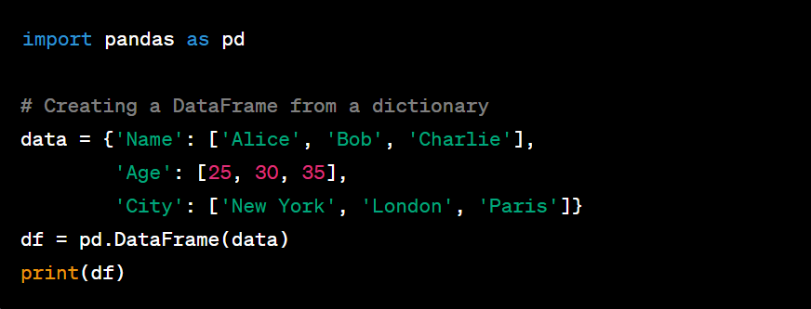
Pandas Data Structures: DataFrame
The DataFrame is a core data structure in Pandas used for tabular data representation.
It consists of rows and columns, similar to a spreadsheet or a SQL table.
DataFrames can be created using various methods in Pandas.

Slide 77
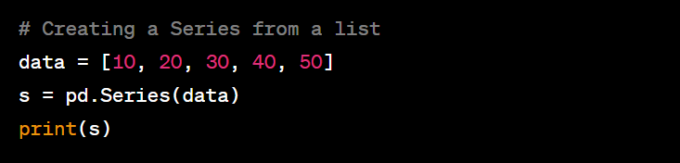
Pandas Data Structures: Series
The Series is a one-dimensional labeled array in Pandas.
It is similar to a column in a DataFrame or a single vector.
Series can be created using various methods in Pandas.

Slide 78
Data Manipulation with Pandas
Pandas offers powerful data manipulation capabilities for working with DataFrames and Series.
Common data manipulation operations include:

Slide 79
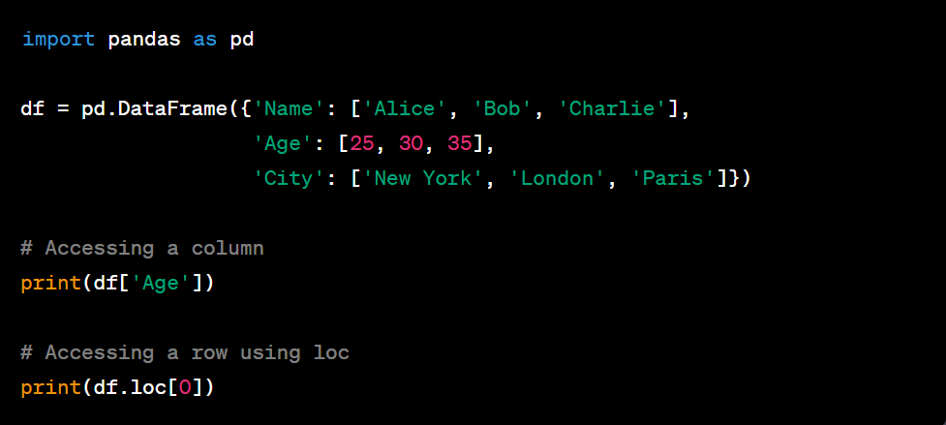
Data Manipulation with Pandas
Indexing and Selection:
Accessing specific rows or columns in a DataFrame.

Slide 80
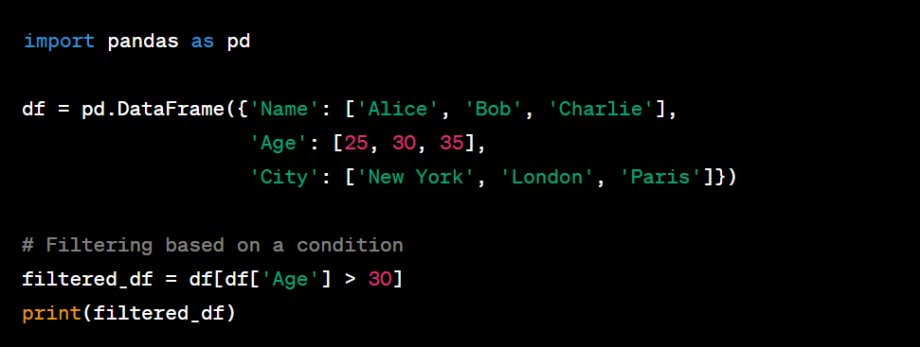
Data Manipulation with Pandas
Filtering:
Selecting rows based on specified conditions.

Slide 81
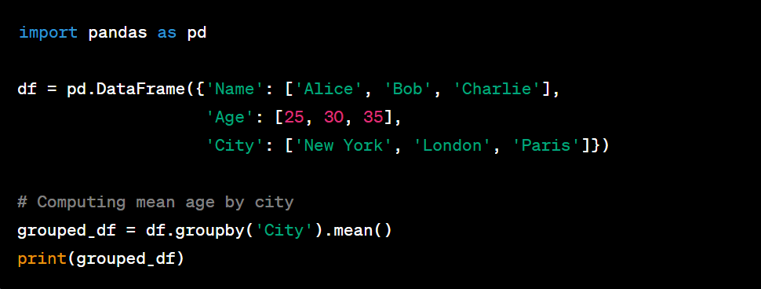
Data Manipulation with Pandas
Aggregation and Grouping:
Computing summary statistics on data or grouping data based on certain criteria.

Slide 82

Data Manipulation with Pandas
Merging and Joining:
Combining multiple DataFrames based on common columns.

Slide 83

Data Cleaning with Pandas
Pandas provides functions for cleaning and preprocessing data.
Common data cleaning tasks include:
Handling Missing Data:
Identifying and filling or removing missing values in a DataFrame.
Example: df.dropna() or df.fillna(value)

Slide 84

Data Cleaning with Pandas
Removing Duplicates:
Identifying and removing duplicate rows in a DataFrame.
Example: df.drop_duplicates()

Slide 85

Data Cleaning with Pandas
Data Transformation:
Applying functions or transformations to modify data.
Example: df.apply(function)

Slide 86

Data Cleaning with Pandas
Data Type Conversion:
Converting data types of columns in a DataFrame.
Example: df['column_name'] = df['column_name'].astype(new_type)

Slide 87
Comparison: Pandas vs. Vanilla Python Data Types
Pandas data types offer several advantages over vanilla Python data types for data analysis.
Differences between Pandas and vanilla Python data types:
Tabular Representation: Pandas provides DataFrame for structured data representation, while vanilla Python has lists and dictionaries.
Data Manipulation: Pandas offers specialized functions for filtering, grouping, and aggregating data, which are not readily available in vanilla Python.
Data Cleaning: Pandas has built-in functions for handling missing data and removing duplicates, simplifying the cleaning process.
Performance: Pandas data types are optimized for large-scale data analysis and offer faster computations compared to vanilla Python.

Slide 88
Advantages of Pandas Data Types
Pandas data types offer several advantages for data manipulation and analysis:
Tabular Structure: Pandas provides a tabular structure (DataFrame) that enables easy indexing, slicing, and manipulation of structured data.
Powerful Functions: Pandas offers specialized functions for data filtering, grouping, aggregation, and more, simplifying complex data operations.
Data Cleaning Capabilities: Pandas provides functions for handling missing data, removing duplicates, and transforming data, improving data quality.
Performance Optimization: Pandas data types are optimized for efficient data processing, enabling faster computations on large datasets.

Slide 89
Disadvantages of Pandas Data Types
While Pandas data types offer numerous advantages, they also have some limitations:
Learning Curve: Working with Pandas requires understanding its syntax and functions, which may have a learning curve for beginners.
Memory Overhead: Pandas DataFrames consume more memory compared to native Python data structures, which can be a concern for large datasets.
Limited Flexibility: Pandas DataFrames have fixed sizes and are less flexible for dynamic data structures compared to native Python lists and dictionaries.
Performance for Small Data: Pandas operations may introduce additional overhead for small datasets, where native Python data structures can be more efficient.

Slide 90

Control Flow
Conditional Statements:
Python uses conditional statements to make decisions in the code.
if statement: Executes a block of code if a specified condition is true.
if-else statement: Provides two possible outcomes. If the condition is true, the code inside the if block is executed; otherwise, the code inside the else block is executed.
if-elif-else statement: Allows for multiple conditions to be checked sequentially. The first true condition's block is executed.

Slide 91

Control Flow
Loops:
Python provides two main types of loops: while and for.
while loop: Repeats a block of code as long as a specified condition is true.
for loop: Iterates over a sequence (e.g., list, tuple) or other iterable objects.

Slide 92

Introduction to OOP
Object-Oriented Programming (OOP) is a paradigm that organises code into reusable and self-contained objects.
Classes and Objects:
A class is a blueprint for creating objects. It defines attributes and methods that the objects will have.
An object is an instance of a class. It can have unique values for its attributes and can perform actions through its methods.

Slide 93
Conclusion
Python is a versatile and powerful programming language.
It features a readable and expressive syntax, making it beginner-friendly.
Python's extensive standard libraries and community support contribute to its popularity.
Key concepts include data types, control flow, object-oriented programming (OOP), and data handling tools (Pandas and NumPy).

Slide 94
Thank You!!!

